Slide 1
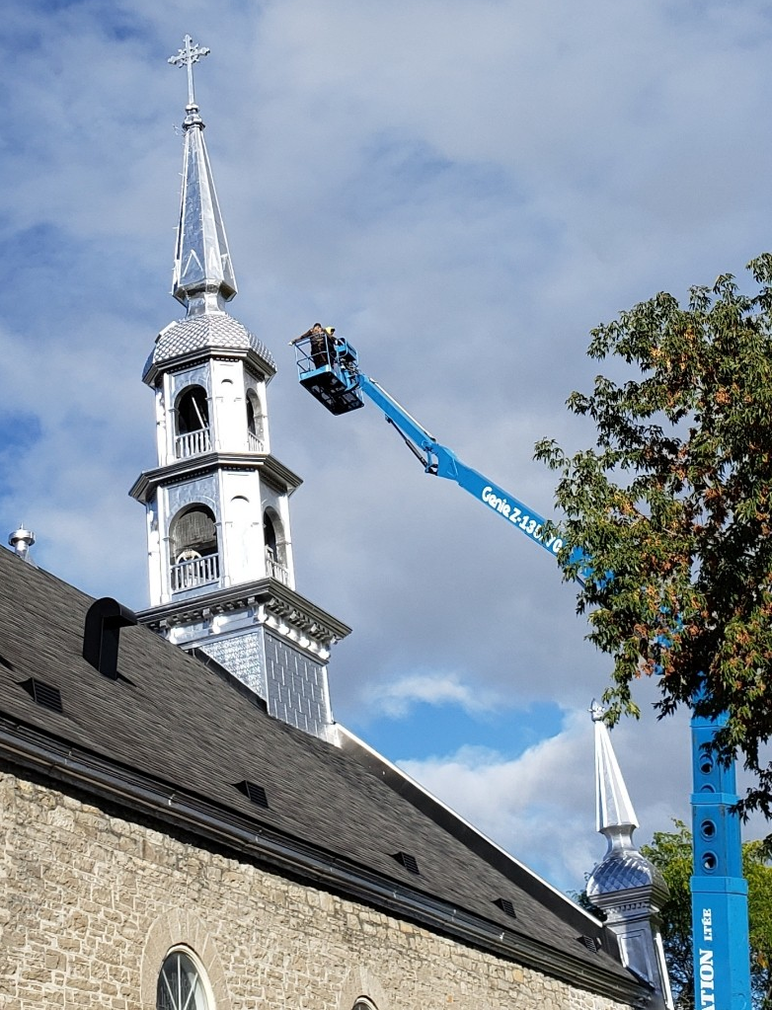
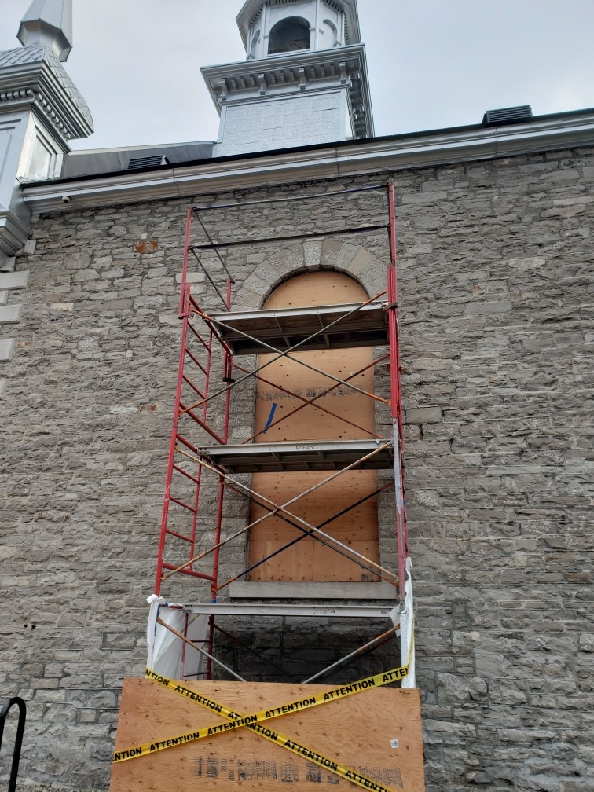
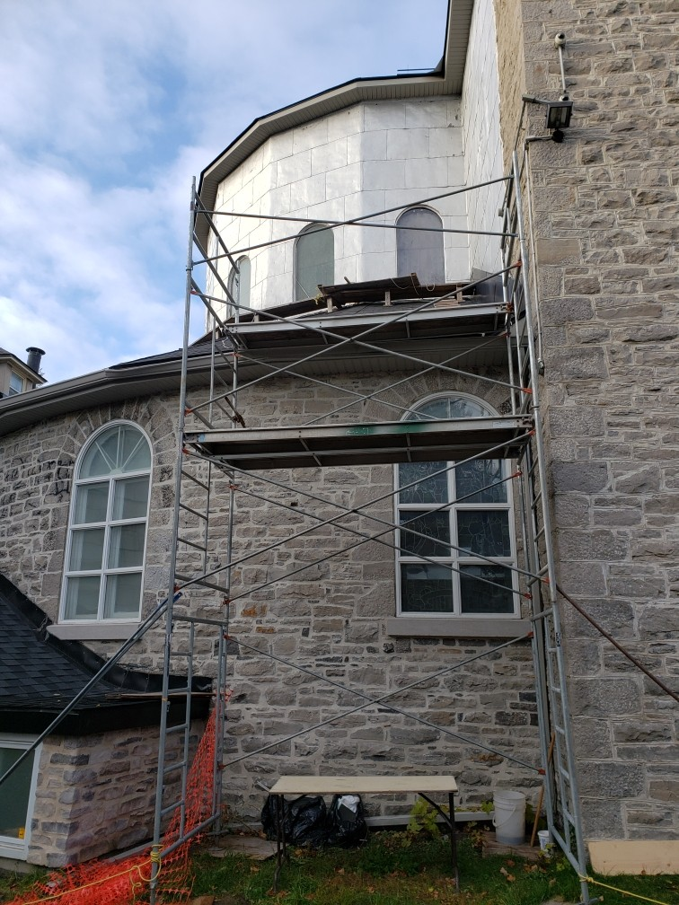
Thank you to all our other generous donors who help make this event a success!
ST. ANNE CHURCH RESTORATION
Financial Donations
GOLF TOURNAMENT
In memory of Mr. Raymond & Mrs. Darlene Tier)
Eagle Automotive
Jeff Gillin
Knights of Columbus (Ontario District)
Manulife & Assante Sherwood Market & Deli (Gabriel Aria)
Metcalfe Family Dental Centre
Wealth Management
Westboro Utilities
A SALUTE TO OUR SPONSORS
We also thank those parishioners who made financial contributions.
August 13, 2024
MEADOWS GOLF & COUNTRY CLUB

Slide 2
BMO Nesbitt Burns offers comprehensive and client-focused investment and wealth advisory services.
Provides strong financial planning options and high-quality products to individuals and businesses.
Contact:
Joshua Wood
www.kennylees.ca
613-790-5938
Thank you to all our other generous donors who help make this event a success!
Platinum Sponsor
($2000)
Silent Auction
Angus Kennedy, parishioner
Art World One
Campagne Quebec-Vie (Arpad Nagy)
Chartwell Rockcliffe
Courtyard Marriott Inn
Edward Jones (Tony Trentatude)
Figaro Coffee House (Trainyards)
Glebe Central Pub
Golf Works
Hampton Inn
Harvest Honey (David Lyons)
Henry Yrenaya
Jacobson’s (Fine foods store)
Jorre de St. Jorre family, parishioners
Kavanaugh Garage
Mara Praulins
McEvoy and Sheilds Funeral Homes
McConnville Garage
Meadows Golf & Country Club
Mercedes-Benz
Musca Wines
NAPA Auto Parts
Oxley Performance Gear (Kelly Doyle, parishioner)
Pacheco Family, parishioners
Petersen's Turf Farms
Randall's Paint and Décor
RBC
Swing of Things
Taing Jewelers
The Baker Tilly Canada Cooperative is a group of leading chartered professional accounting firms.
Offering value‑added audit, tax and advisory solutions for every major industry sector.
Contact:
www.bakertilly.ca
(613) 820-8010
Bronze Sponsor
($300)
A team of National Bank professionals helping individuals and businesses build, manage and protect their wealth.
Comprehensive financial planning and portfolio management.
Contact:
Serge Duhaime
www.nbc.ca
613-236-0103
Bronze Sponsor
($300)
2

Slide 3
Gabriel News is your free source for the most important daily Canadian news.
They will produce legal analysis and short videos to cut through the fog of the mainstream narrative.
Contact:
Stéphane Lalonde
www.gabrielnews.ca
Knights of Columbus Insurance provides members and their families access to trusted insurance and disability products.
A financially strong and ethical organization offering every member the financial protection they deserve.
Contact:
Vincent D’Souza
https://www.kofc.org
(613) 255-0637
Bronze Sponsor
($300)
FREE!
Bronze Sponsor
($300)
Gold Key provides residential, condo and commercial property management services in Ottawa and surrounding areas.
Trusted by some of the largest real estate owners to protect and grow their assets’ values.
Contact:
Michael Caparelli
613-725-1111
Parishioner Frank Fragomeni is a Royal Lepage real estate broker with over 25 years of experience.
Frank’s mission is to help buyers and sellers navigate the entire process of their real estate transaction well beyond the closing date.
Contact:
Frank Fragomeni
www.royallepage.ca
613-831-9287
Silver Sponsor
($500)
Bronze Sponsor
($300)
Blinds To Go is your one-stop shop for blinds, shades, drapery and shutters at factory-direct prices.
3 Ottawa locations (Kanata, Nepean and St. Laurent) in Ottawa to serve customers around the city.
Contact:
Cheena Cottrell
www.blindstogo.com
613-410-8577
M&T Glass is a leader in the glass and window industry.
With over 50 years experience, they have the expertise to help with any glass and window needs for your home or business.
Contact:
Elie Salameh
613-145-7158
Silver Sponsor
($500)
Silver Sponsor
($500)
10
3

Slide 4
Grow Green is a locally owned and operated full-scale landscaping company in the greater Ottawa region.
Specializing in landscaping, interlock, garden and pool patio design.
Contact:
Josh Saikaley
www.growgreen.ca
613-293-7667
Tony Graham Automotive Group serves customers with two Toyota dealerships and one Lexus location.
Stittsville location includes their Collision Centre and Auto Edge outlet offering used vehicles of all makes and aftermarket parts.
Contact:
www.tonygraham.com
(613) 225-1212
Silver Sponsor
($500)
Gold Sponsor
($1000)
Maize Siding & Eavestroughing specializes in the installation and replacement of gutters, siding and soffit/fascia.
A full-service local business servicing the Ottawa-Cornwall-Renfrew region.
Contact:
Alexis Maisonneuve
www.maizeinc.ca
613-488-3419
Myers’s group of 17 Ottawa dealerships is your go-to destination for Cadillac, Buick, GMC, Chevrolet, Dodge, Chrysler, Jeep, RAM, Subaru, Nissan, Toyota, Hyundai, Infinity, and Volkswagen.
Contact:
www.myers.ca
613) 225-2277
Bronze Sponsor
($300)
Silver Sponsor
($500)
Rancourt Roofing is a family-owned local roofing company ready to cater to all your roofing needs.
Servicing the Ottawa-area and specializing in residential, commercial and insurance clients.
Contact:
Luc Rancourt
www.rancourtroofing.com (613) 292-6859
Surgenor Automotive Group’s 4 Chevrolet, GMC, Cadillac, Buick and Hyundai dealerships serve customers in Ottawa and Gatineau.
Surgenor also operates 2 truck centres and offers vehicle leasing.
Contact:
www.surgenor.com
(613) 741-0741
Bronze Sponsor
($300)
Silver Sponsor
($500)
4
9

Slide 5
Tunes On Wheels is your mobile Bicycle & Ski Shop
Ottawa and Gatineau’s solution to convenient and professional Bicycle and Ski Service, Sale and Rental.
Offering online sale of parts, accessory and gear. Contact:
Julien Chort
www.tunesonwheels.ca
343-202-4392
CM3 is an environmental consulting firm that provides professional services to clients who insure, manage, develop, or market real property and buildings.
Expertise in soil and water contamination, hazardous buildings, mould and asbestos.
Contact:
Rob McGrath
www.cm3environmental.com
(613) 838-2323
Bronze Sponsor
($300)
Silver Sponsor
($500)
RMA+SH architects is an award-winning architectural firm with a strong heritage specialization.
Combining contemporary design, historical preservation and environmental consciousness to shape tomorrow’s history in the present.
Contact:
Robert Martin
RMA+SH architects (rma-sh.com)
(613) 567-1361
AVB Integration Services Inc. is an Ottawa-based company providing services to the audio-visual and broadcast industries.
Specializing in design, management, installation and integration of complex systems.
Contact:
David Pratt
www.avbintegration.com
(613) 695-2824
Bronze Sponsor
($300)
Bronze Sponsor
($300)
Whelan Funeral Home is a local, family-owned and independent business providing a full range of services to the Ottawa area.
Serving one family at a time in their time of need.
Contact:
Sean Copeland
www.whelanfuneralhome.ca
(613) 233-1488
Kodiak Security provides and installs advanced electronic security systems.
They keep your family or business safe and secure in challenging times.
Contact:
Mo Sottile
www.kodiaksecurity.ca
(613) 737-4553
Bronze Sponsor
($300)
Silver Sponsor
($500)
8
5

Slide 6
Cléroux Rénovation has been restoring churches and heritage buildings since 1985.
Contact:
Alain Cléroux
www.clerouxrenovation.ca
+1 800-816-6665
Royal Building Solutions offers professionals a full line of industry-leading building materials, products, accessories and tools.
Contact:
Caleb Tier, Parishioner
www.royalbuildingsolutions.com
(613) 744-1121
Bronze Sponsor
($300)
Gold Sponsor
($1000)
W.O. Stinson & Son Ltd. offers a complete line of motor oil, lubricants, petroleum and propane products, in addition to a full range of home comfort equipment and services.
Contact:
Lisa Stinson
www.wostinson.com
613 822-7400
Claude Lauzon Group is a family-run lessor specializing in the purchase, renovation and rental of housing and commercial space.
Contact:
Lise Lauzon
www.claudelauzongroup.ca
(613) 241-1600
Bronze Sponsor
($300)
Bronze Sponsor
($300)
Goldie Mohr Ltd. Is a heavy civil construction company.
The scope of their work includes site preparation, custom trucking, float services, topsoil manufacture, aggregate and winter maintenance.
Contact:
Deborah Mohr-Caldwell
www.goldiemohrltd.ca
(613) 838-5042
Silver Sponsor
($500)
6
7

